Slide 1
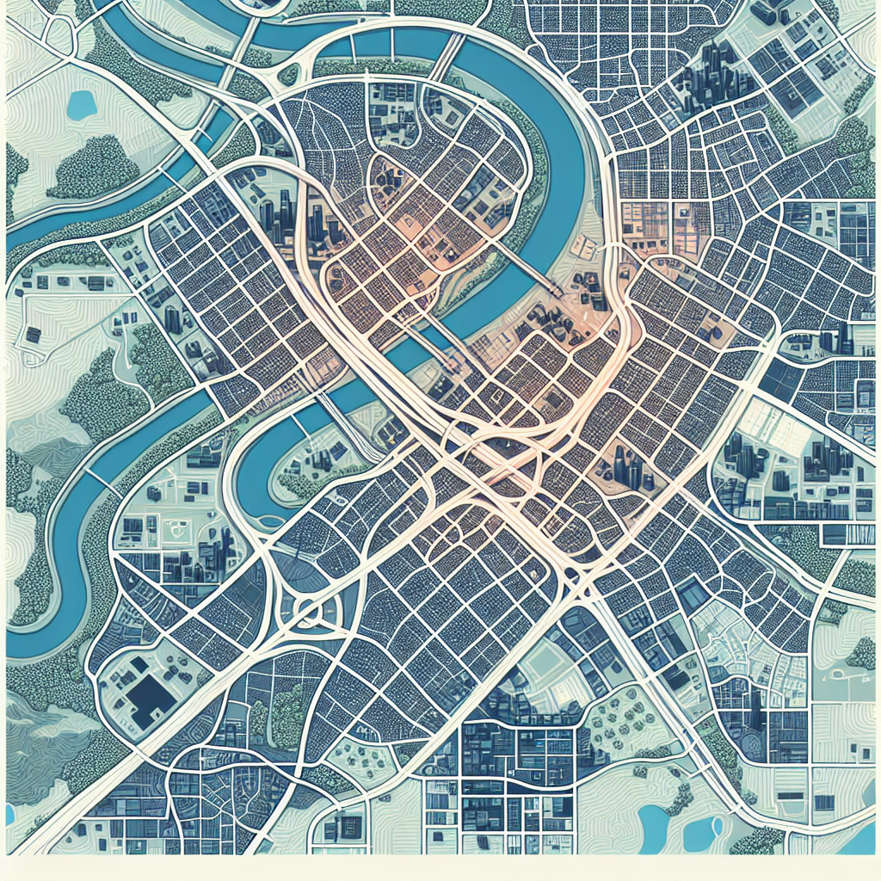
Costs and Benefits (Illustrative, per 100k residents, 10‑yr NPV @3%)
Quick‑build pilots (paint/posts/planters): $12M
Permanent streetscape + bikeways: $85M
Transit priority upgrades: $30M
Public realm/trees/stormwater: $18M
Ops/maint. (net of savings): $22M
Curb pricing/parking reform: -$28M
Speeding/crash cost reductions (city savings): -$15M
Travel time saved (mode shift/shorter trips): -$190M
Health (active mobility; reduced PM2.5): -$120M
Crash reduction (ped/bike/veh): -$150M
Retail uplift/local spending retention: -$60M
GHG reduction (social cost of carbon): -$25M
Legend: Costs, Offsets, Benefits, Net
Notes: Monetization methods per standard CBA (e.g., USDOT guidance); tailor to local context.

